Slide 1
School Building Project
A Detailed Architectural Plan

Slide 2
Team Details
1.Subhraneel Bag-24CE10111
2. Shrehan Raj Singh-24CE10103
3. Sk Toufik Haque- 24CE10106
4.Ayan Kumar-24CE10037
5.Khade Aditya Santosh-24CE10070
6.Ayush Nayal-24CE10040
7.Rushil Ajaria-24CE10094
8.Shourya Vinod Singh-24CE1002
9.Hiya Agarwal-24CE10061
10.Amish Khare-24CE10029
11.Arsh M. Rashania-24CE10034
12.Abhay-24CE10023

Slide 3
Project Overview
This presentation provides a structured view of the school building project. Each floor plan is displayed separately, followed by its detailed description. Dimensions and layout details are included for clarity.

Slide 4
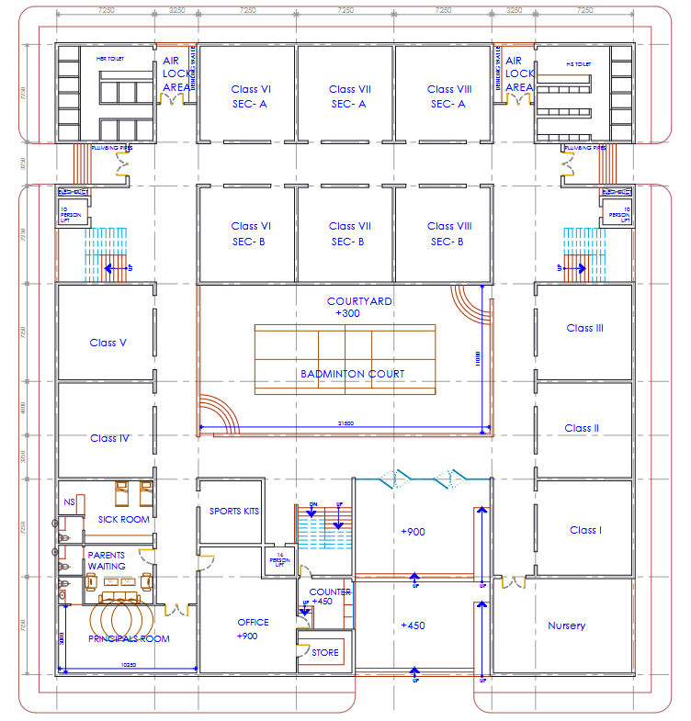
Ground Floor Plan Layout

Slide 5
Ground Floor Plan - Details
The ground floor includes the following primary classrooms and administrative sections:
Nursery to Class VIII classrooms (Each: 7m x 7m)
Principal’s Office (5m x 10.25m), Office (7.5m x 7m)
Parents’ Waiting Area (4m x 7m), Sick Room (5m x 7m)
Courtyard with Badminton Court (21.5m x 11m)
Staircases and accessible pathways for easy movement
Sports kits room, Store and Counter

Slide 6
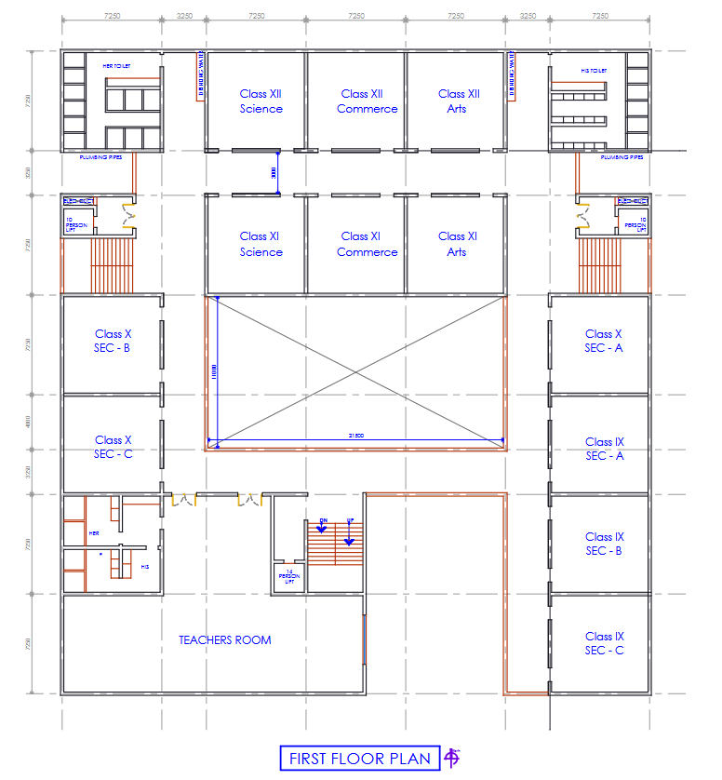
First Floor Plan Layout

Slide 7
First Floor Plan - Details
The first floor hosts secondary-level classrooms and faculty rooms:
Class IX to XII classrooms (Each: 7m x 7m)
Separate boys’ and girls’ restrooms on each wing and drinking water stations.
Teachers’ Lounge (17.5m x 7m) for faculty members.
Staff and student elevators.

Slide 8
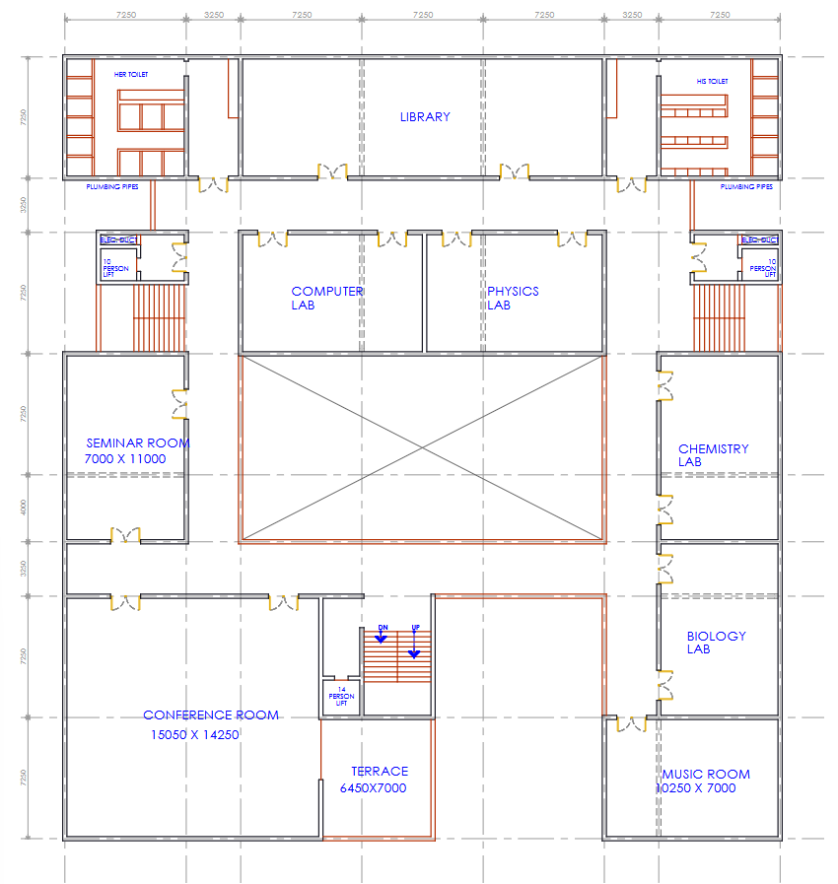
Second Floor Plan Layout

Slide 9
Second Floor Plan - Details
The second floor is designed for specialized academic and extracurricular spaces:
Science Labs (Physics, Chemistry, Biology) - (Each: 11m x 7m)
Library with reading area (12m x 21.5m)
Computer Lab with modern systems (11m x 7m)
Music Room for creative learning (10.5m x 7m)
Seminar room for holding events
Large Conference room for meetings (15.05m x 14.25m)
Terrace for fresh air (6.45m x 7m)

Slide 10
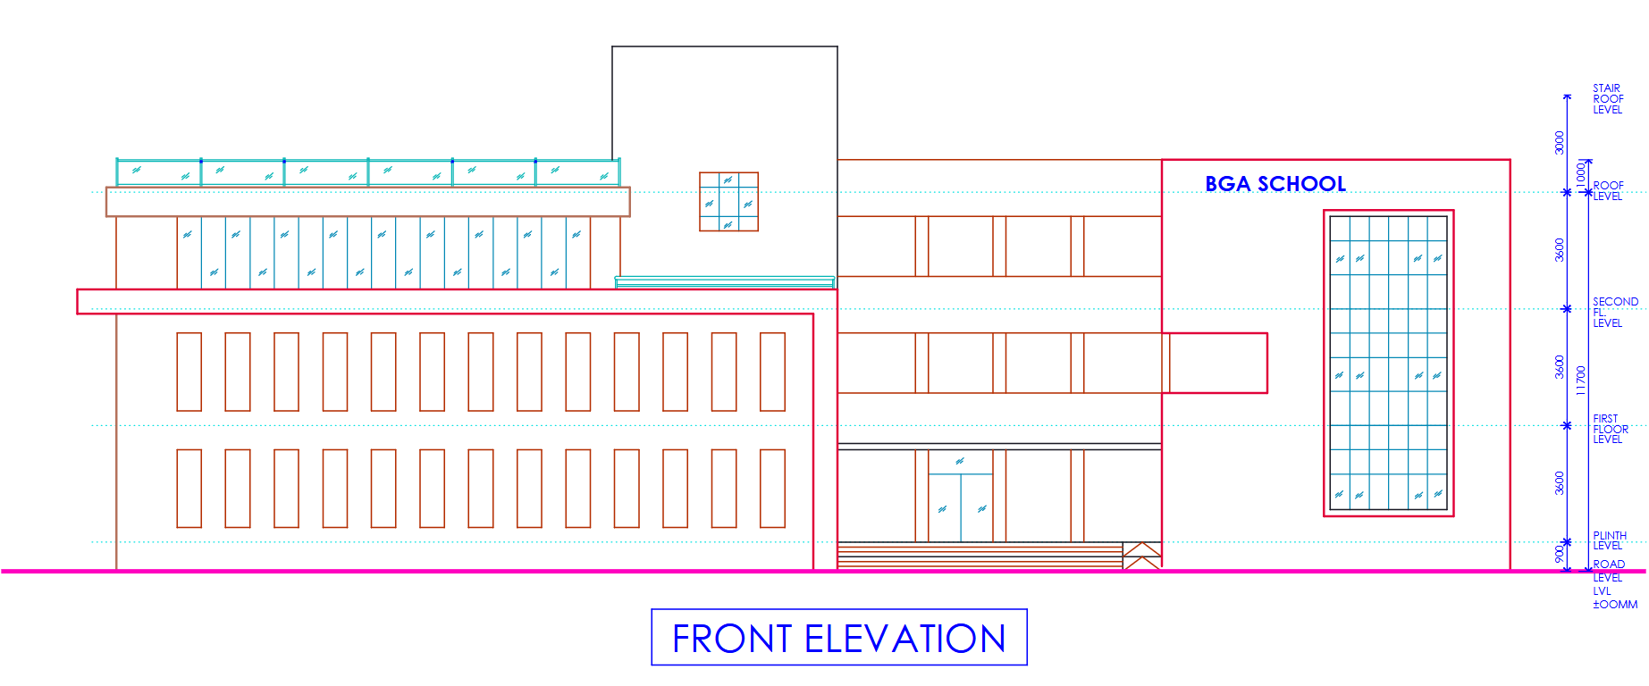
Front Elevation - Layout

Slide 11
Front Elevation - Details
The front elevation showcases the school’s modern design:
Large entrance with pedestrian pathways and ramp for wheelchair
Spacious parking area for staff and visitors
Green landscaping for a pleasant environment
Wide windows for natural light and ventilation

Slide 12
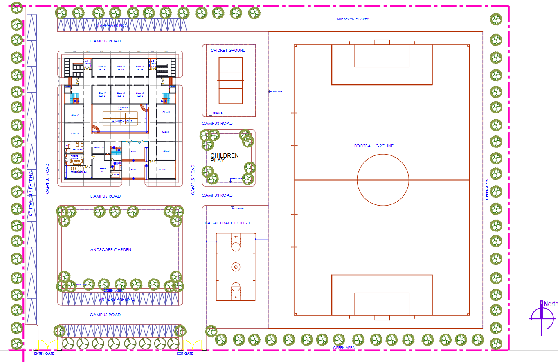
Whole School Plan - Layout

Slide 13
Whole School Plan - Details
The complete school layout ensures a well-structured learning environment:
G+2 Building for the School with doubly loaded corridors.
Badminton Court, Basketball Court, Cricket Ground, Football Ground and Children's Playground.
Safe entry and exit points for students and staff.
Landscaping and pathways for a structured movement system.
Different parking spaces for school bus, school staff and visitors.

Slide 14
Conclusion
The school building project is meticulously designed for optimal academic and extracurricular growth. The well-planned structure ensures smooth operations, safety, and a dynamic learning experience.

Slide 15
Structural & Material Considerations
1. Foundation
Reinforced Concrete (RCC): Provides strong load-bearing capacity and resistance against earthquakes.
Piles or Deep Footings: Used in areas with weak soil conditions to enhance stability.
Stone Foundation: Traditional and durable, especially in regions with ample stone resources.
Steel Reinforced Concrete (SRC): An advanced version of RCC that incorporates additional steel for enhanced strength.
2. Walls
Brick Masonry: Durable and cost-effective, commonly used with cement mortar and plastering.
Concrete Blocks: Stronger and provide better thermal insulation than bricks.
Precast Concrete Panels: Quick to install and durable, reducing construction time.
Autoclaved Aerated Concrete (AAC) Blocks: Lightweight, fire-resistant, and excellent for insulation.
Timber Walls: Suitable for temporary or eco-friendly schools, especially in rural or forested regions.
Glass Curtain Walls: Used in modern designs to allow more natural light and aesthetics.
Solar Panels: For sustainable energy generation.
Cork Boards & Soft Boards: Used for bulletin boards and classroom walls.
Fireproof and Water-resistant Paints: Ensure safety and durability.

Slide 16
3. Roof
Reinforced Concrete Slab (RCC): Durable and strong, with added waterproofing for longevity.
Metal Roofing (Aluminium, Steel, or Zinc Coated): Lightweight and ideal for sloped roofs.
Clay or Concrete Tiles: Used in warm climates for better heat resistance.
Green Roofs (Vegetation on Waterproof Layers): Helps with insulation and environmental sustainability.
Polycarbonate Panels: Allow natural light while being impact-resistant.
4. Flooring
Vitrified Tiles: Non-slip, easy to maintain, and suitable for high-traffic areas.
Ceramic Tiles: Used in restrooms and laboratories due to water resistance.
Terrazzo Flooring: Durable and commonly used in corridors and public spaces.
Vinyl Flooring: Soft, slip-resistant, and used in classrooms and play areas.
Rubber Flooring: Provides comfort and safety, commonly used in special needs classrooms and playgrounds.
Polished Concrete: Cost-effective and highly durable for hallways and auditoriums.

Slide 17
5. Doors & Windows
Aluminium Frames with Glass Panels: Lightweight, rust-resistant, and allows natural light.
Wooden Doors: Used for classrooms and offices, providing good insulation.
Steel Doors: Used for emergency exits due to fire resistance.
UPVC (Unplasticized Polyvinyl Chloride) Windows: Energy-efficient and low maintenance.
Tempered or Laminated Glass Windows: Ensures safety by reducing the risk of breakage.
6. Load-Bearing Capacity & Structural Reinforcement
Steel Beams and Columns: Provide structural support, especially in multi-story buildings.
Reinforced Concrete Frames: Designed to withstand seismic and wind loads.
Bracing Systems (Cross-bracing, Shear Walls): Improve earthquake resistance.
Fiber-Reinforced Polymer (FRP) Reinforcements: Lightweight yet strong for additional support.

Slide 18
Safety & Sustainability Features
The school incorporates various safety and environmental considerations:
Emergency Exits & Fire Safety: Clearly marked fire exits and fire extinguishers on each floor
Natural Ventilation & Lighting: Maximized through large windows and courtyard design
Energy Efficiency: Use of LED lighting, lots of natural light and provision for solar panels
Water Management: Rainwater harvesting system and proper drainage planning
Disabled Accessibility: Ramps , elevators and wide doorways for wheelchair access

Slide 19
Key Learnings from the School Building Project
Understanding floor planning to optimize classroom layout, office spaces, and movement corridors.
Learning to create detailed project plans, CAD drawings, and reports.
Understanding construction project phases (planning, approval, execution).
Experience in collaborating with teams and presenting technical information.

Slide 20
THE END

